Slide 3


Pablo Peris
MCS Engagement Manager
Microsoft Newbie - SharePoint Veteran
@pabloperis

Slide 4
Bottom-up Knowledge Management: Boards, Delve y Office Graph

Slide 5

Couldn’t you come up with a shortest title?

Slide 6
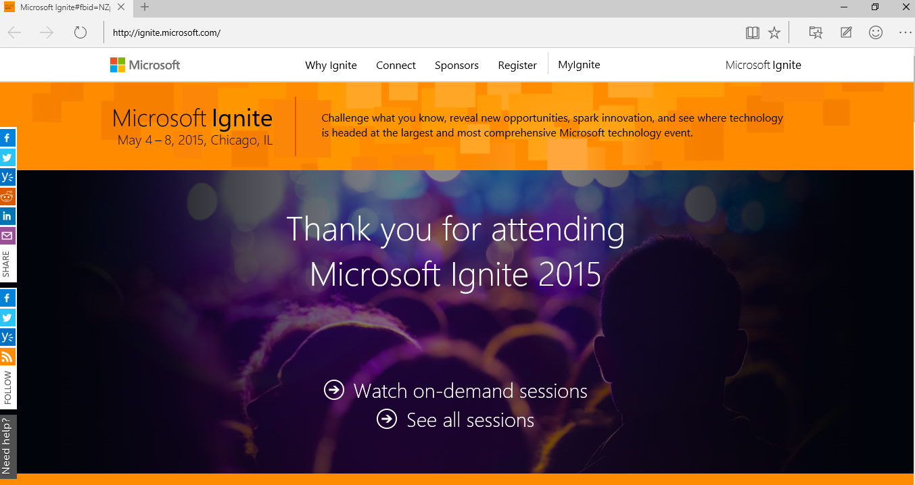

Slide 7
Disclaimer: All based on Ignite Sessions
Tuesday (5/5/2015)
BRK2173 | Intelligent, Ready-to-Go NextGen Portals in Office 365 |  | Adam Harmetz; Mark Kashman | 9:00AM | S103
BRK1105 | Office Delve and Office Graph Vision and Roadmap |  | Ashok Kuppusamy, Cem Aykan, Fredrik Holm | 10:45AM | S102
Wednesday (5/6/2015)
BRK2176 | A New People Experience in Delve: Discover People Through Content, and Content Through People | Stefan Debald; Welly Lee |  | 10:45AM
BRK2174 | The New Knowledge Management Portal in Office 365 | Christopher Kehler; Victor Poznanski |  | 1:30PM | S104
BRK2133 | Collaborate on Files and Information within Office 365 Groups | Andrew Haon; Eric Zenz |  | 3:15PM | S100
BRK2107 | Break Down Organizational Silos and Gain New Insights with Office Graph and Office Delve | Gary Danoys and Steve Nguyen |  | 3:15PM | S103
BRK3134 | Implementing Next Generation SharePoint Hybrid Search With The Cloud Search Service Application | Manas Biswas, Kathrine Hammervold |  | 5:00PM | S404
Thursday (5/7/2015)
BRK3155 | Office 365 Video and Custom Solutions Built on Azure Media Services | Ashish Chawla; Marc Mroz |  | 9:00AM | S105d
BRK2205 | Behind the scenes: Engineering NextGen Portals | Daniel Kogan; Jeremy Kelley |  | 9:00AM | E350

Slide 8
Agenda
Finding Content through People
‘Unmanaged’ KM
Q&A
‘Bottom-up’
Delve and Office Graph
Boards
Next Gen Portal

Slide 9

My personal experience

Slide 10

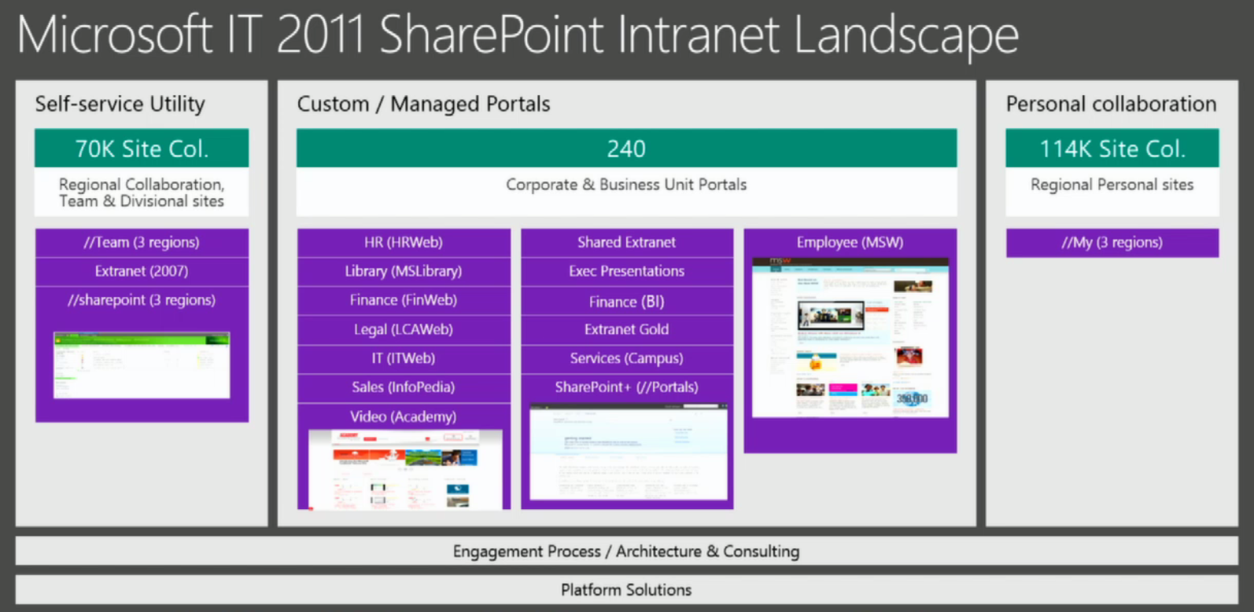
My Personal Experience as new employee at Microsoft:
A myriad of places where knowledge was available

Slide 11
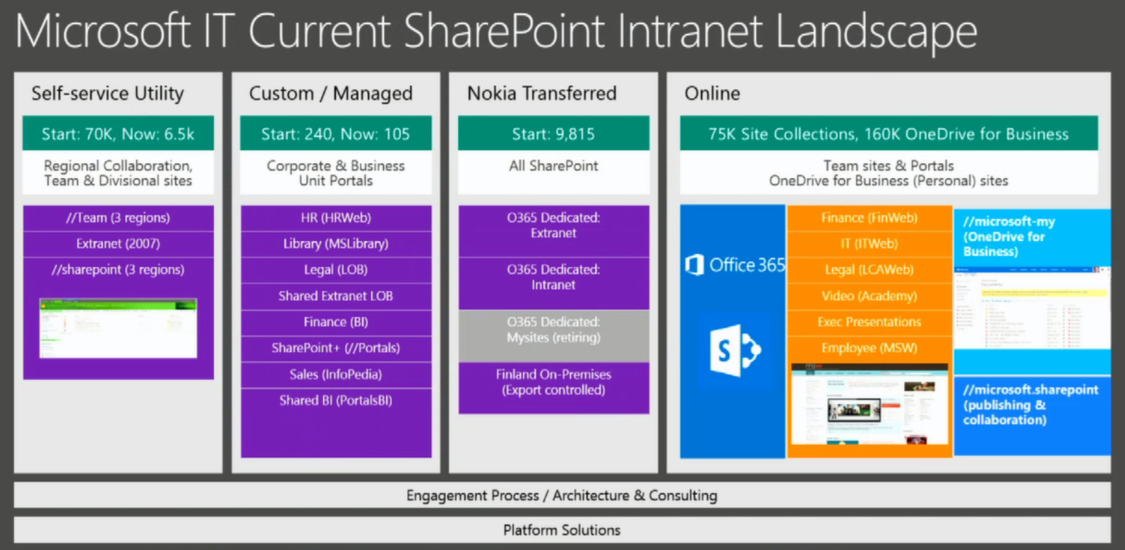
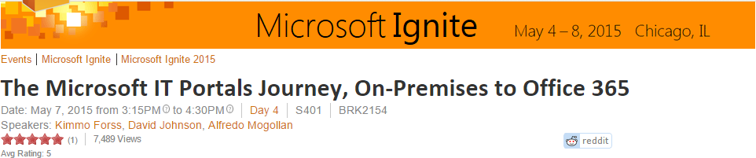
Even after the cloud migration, there still were too many places to search for info.

Slide 12
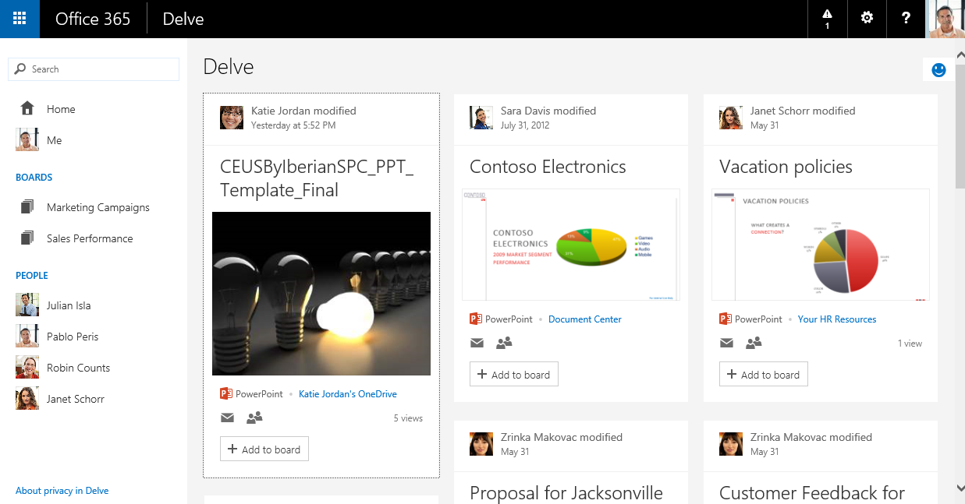
Delve: The only tool that really helped me during the onboarding process

Slide 13
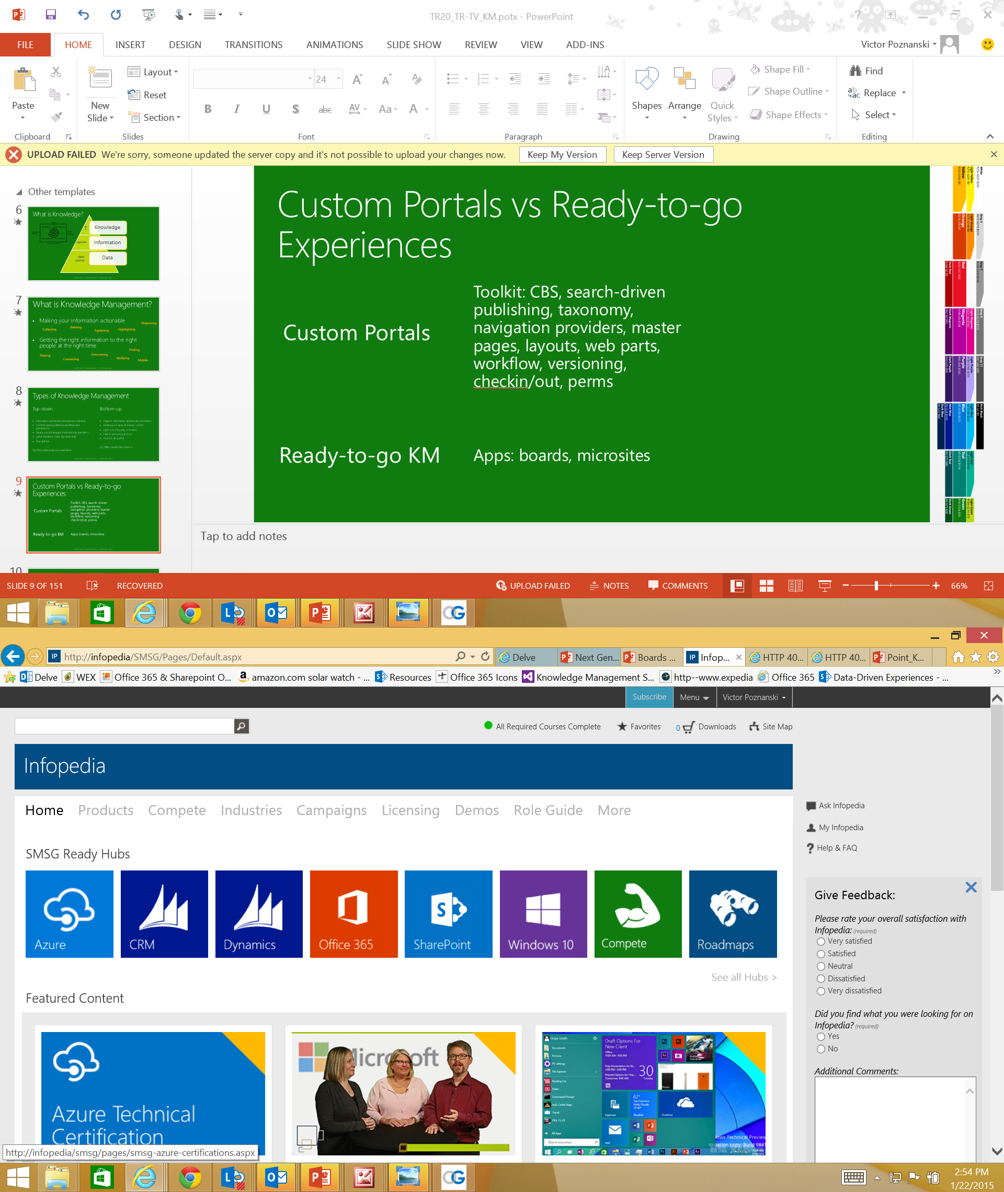
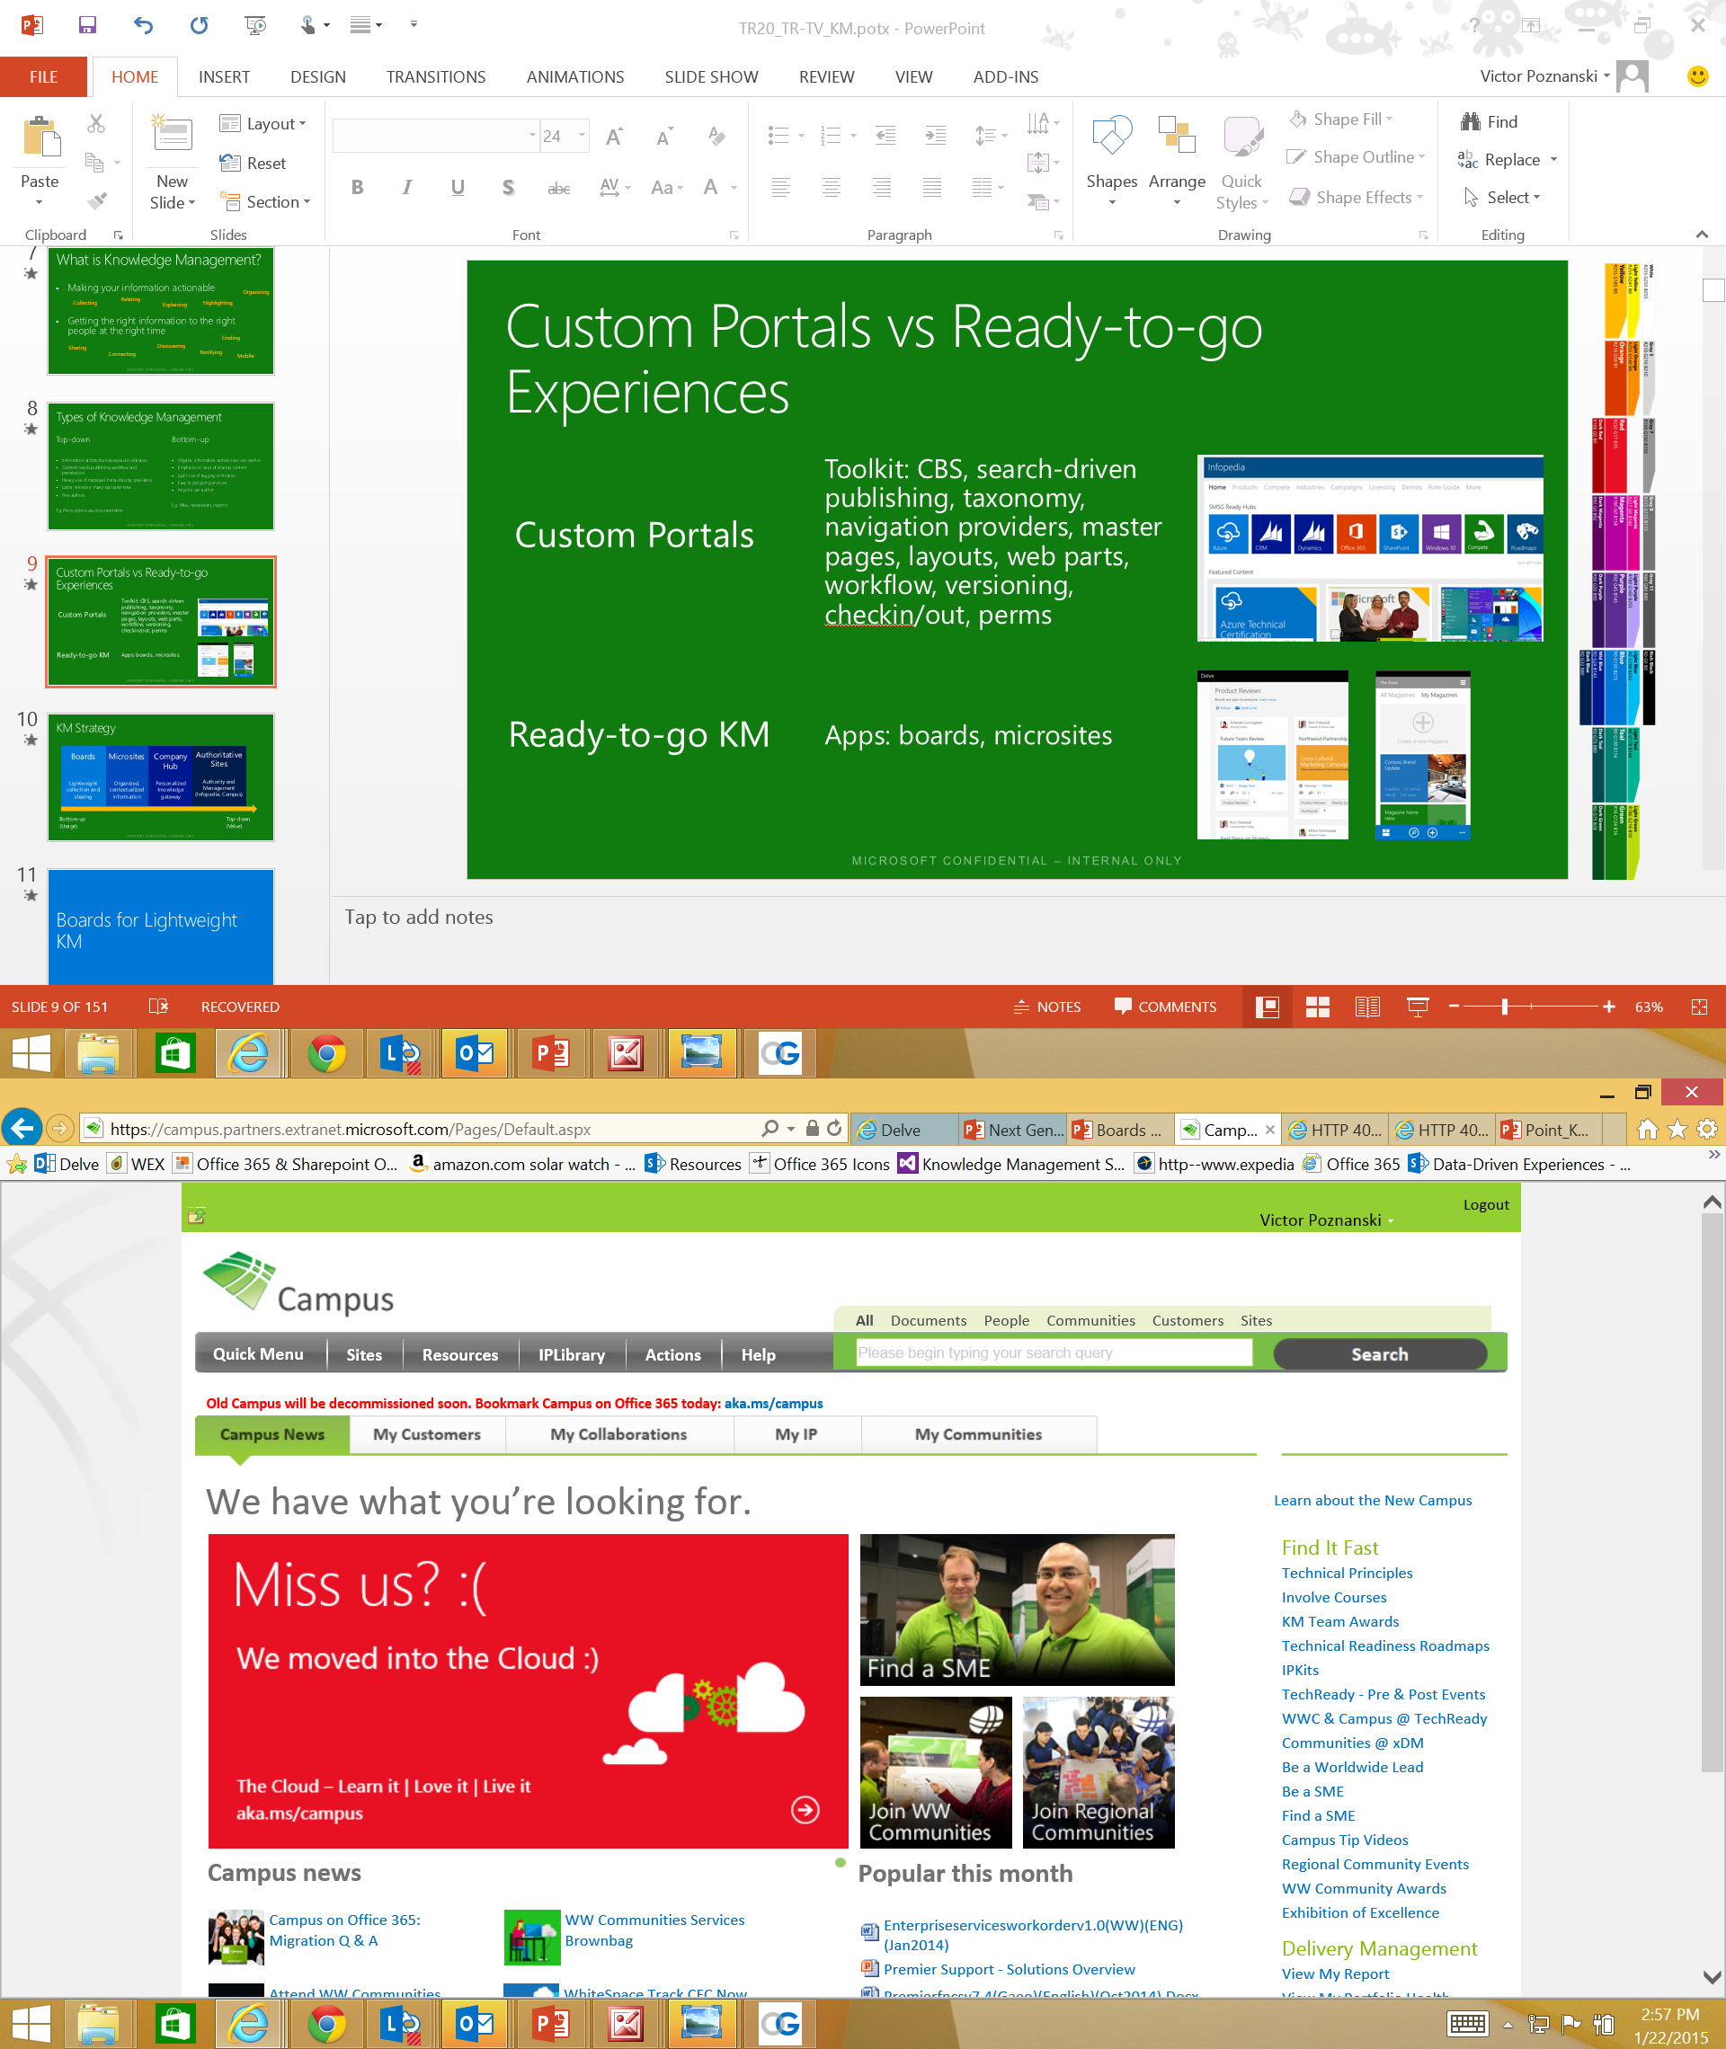
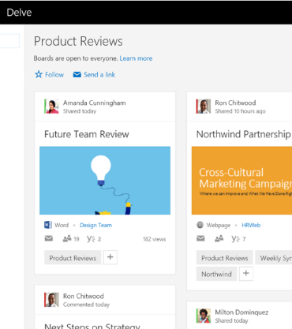
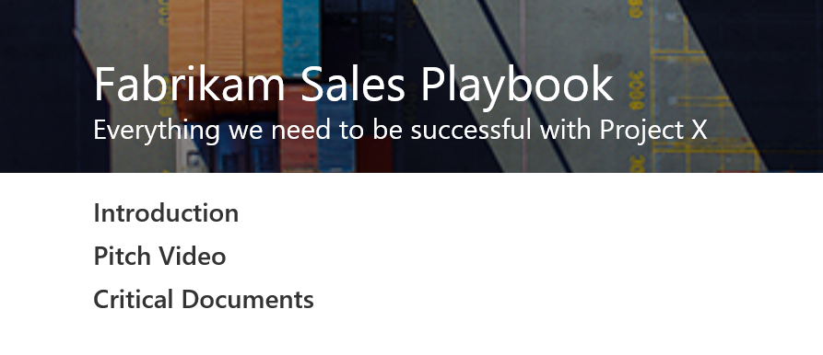
SharePoint Portals vs Ready-to-go Experiences
SharePoint Portals: Toolkit
Search-driven publishing, taxonomy, navigation providers, master pages, layouts, web parts, workflow, versioning, checkin/out, perms…
Ready-to-go KM
Boards, microsites surfaced in Codename Infopedia

Slide 14



NextGen Portals: Meet the Family
O365 Video
Delve
O365 “InfoPedia”
Build Your Own
Video
Delve
“InfoPedia”
Your Portal
Mobile
Intelligent
Social
“Ready to go”
Enhanced by key Office 365 Capabilities
Office Graph
Office Add-Ins
OneDrive
Skype
Outlook
Compliance Center
Yammer
SharePoint Content Management
Azure Media & other Azure PaaS Services

Slide 15
Knowledge Management Strategy
Boards
lightweight collection and sharing
Microsites
organized, contextualized information
Codename
Infopedia
personalized knowledge gateway
Bottom-up
(Usage)
Top-down
(Value)

Slide 16
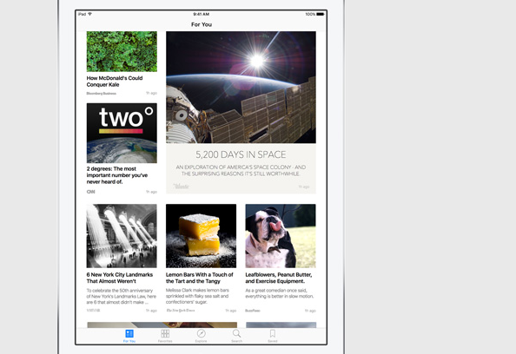
Boards

Slide 17
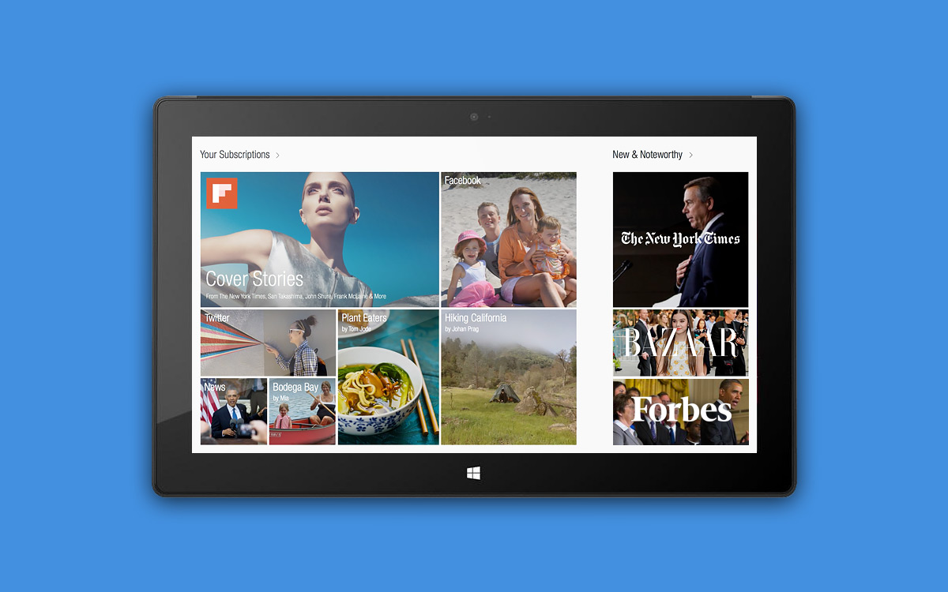

Slide 18
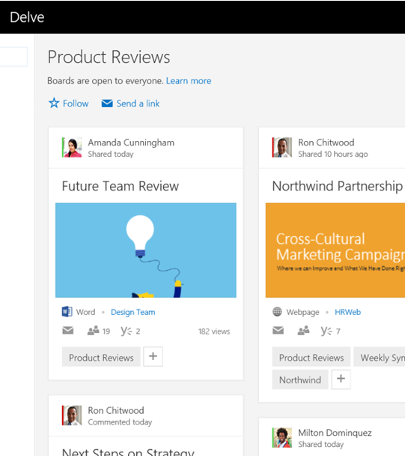
Collecting with Boards
Problem: Information gets fragmented and scattered
Boards are an easy way to collect and share fresh content
Collaborative: anyone can contribute and mail links
“add to board” is integrated into Delve

Slide 19

Boards demo

Slide 20
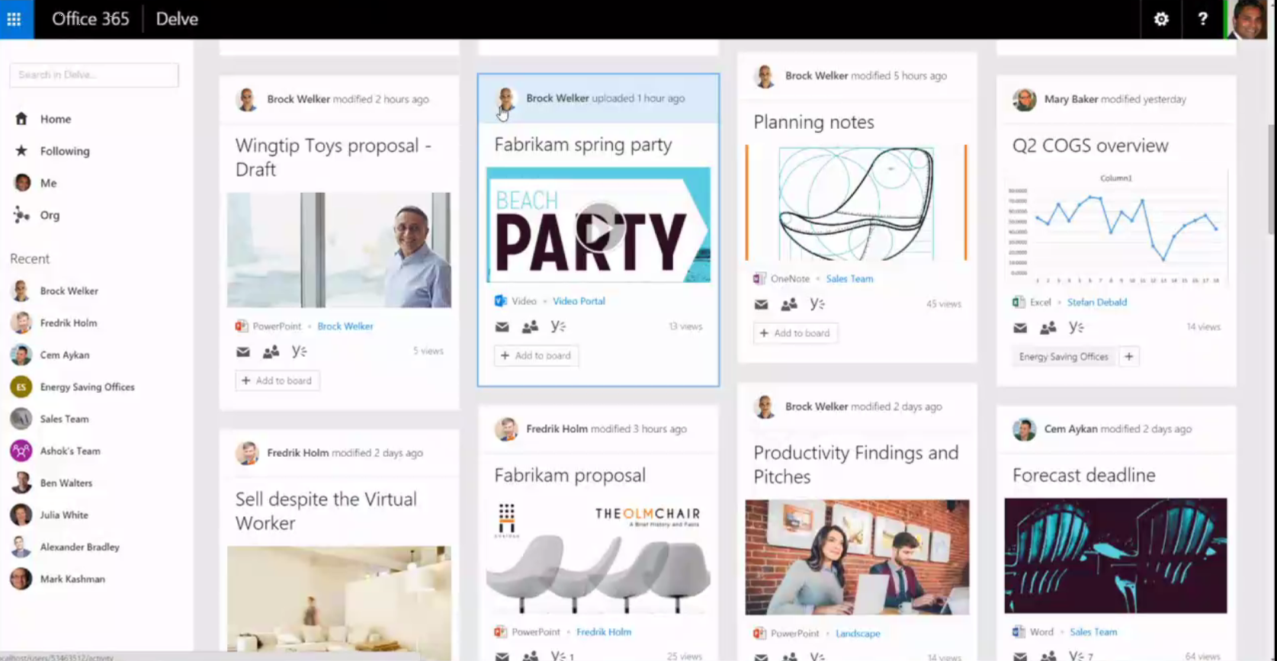

Slide 21
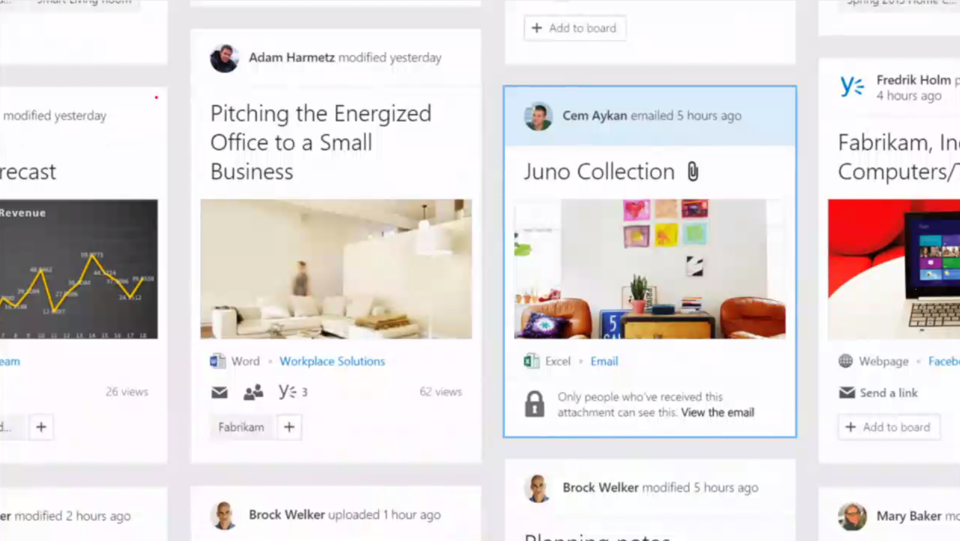

Slide 22
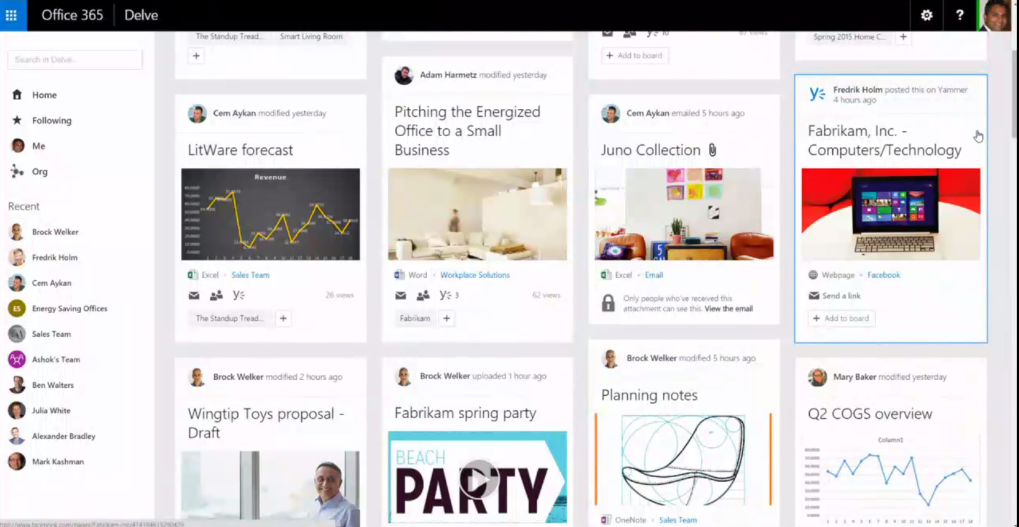

Slide 23
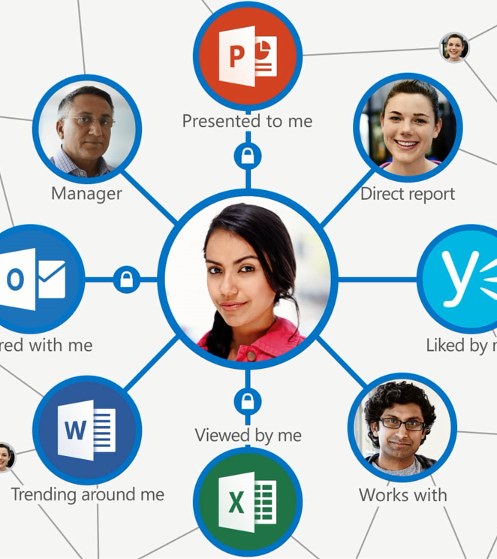
So what exactly is an Office Graph, and who is Delve?

Slide 24
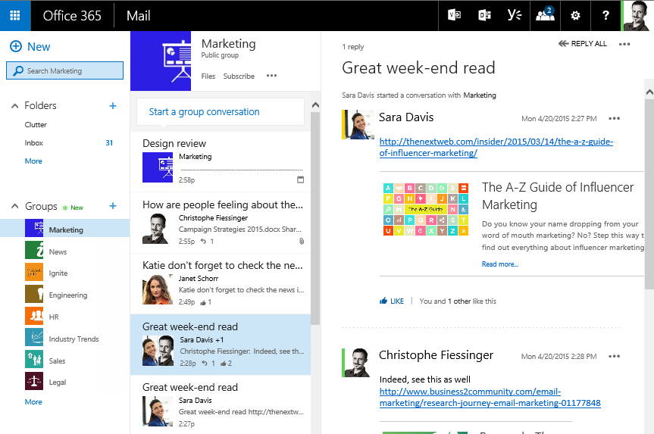
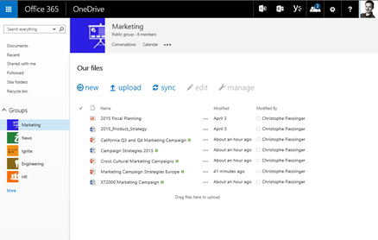
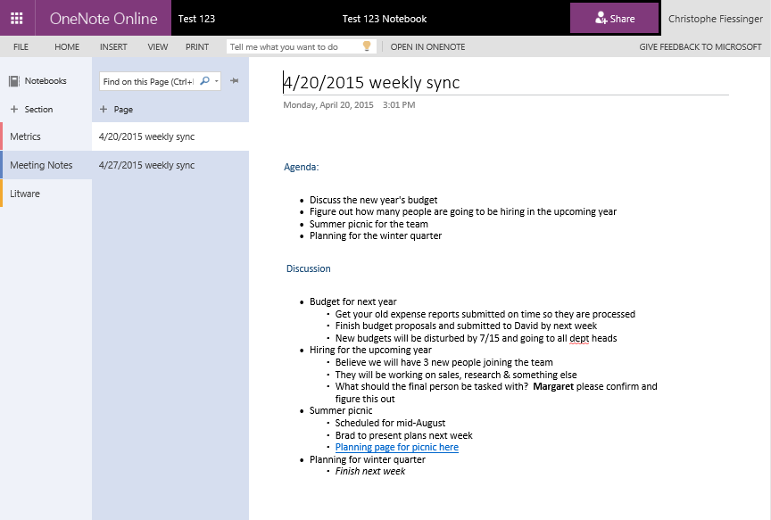
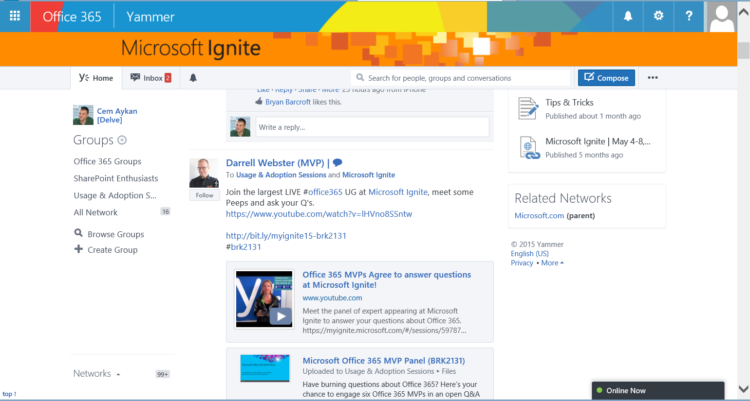
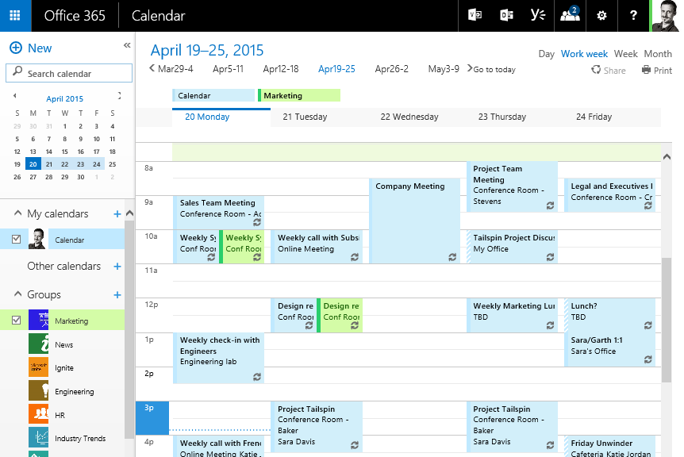
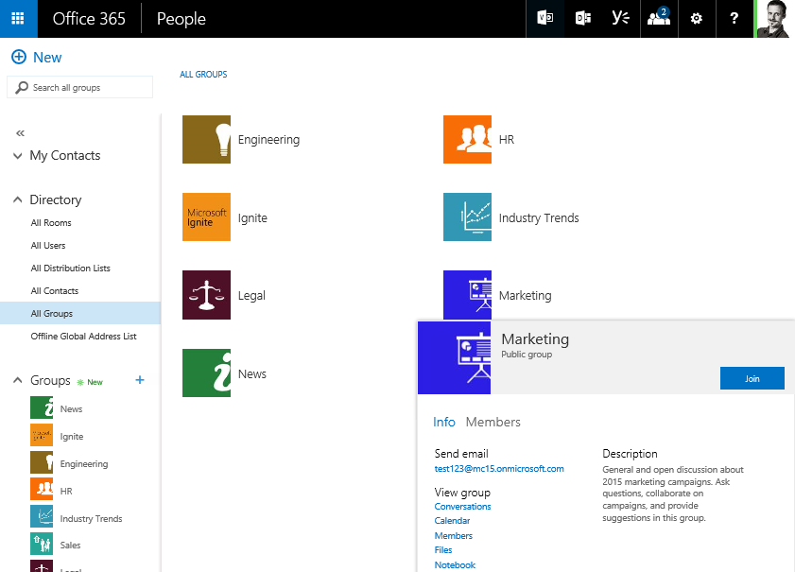
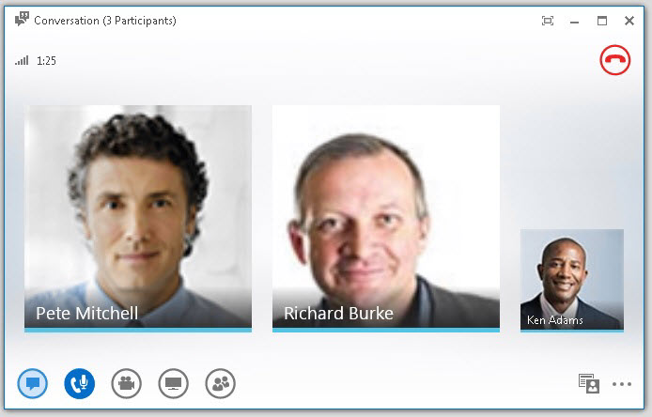
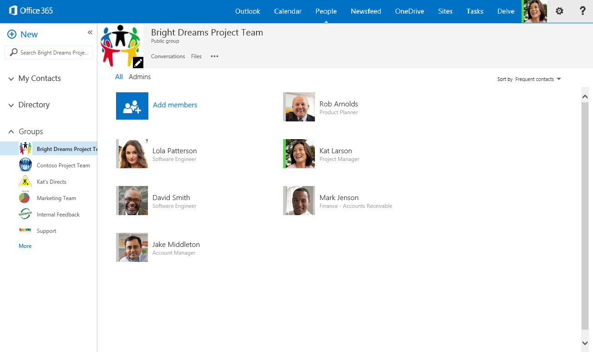
Today at work we use many different tools…
MAIL
FILES
ONENOTE
…
CALENDAR
Yammer
SKYPE

Slide 25
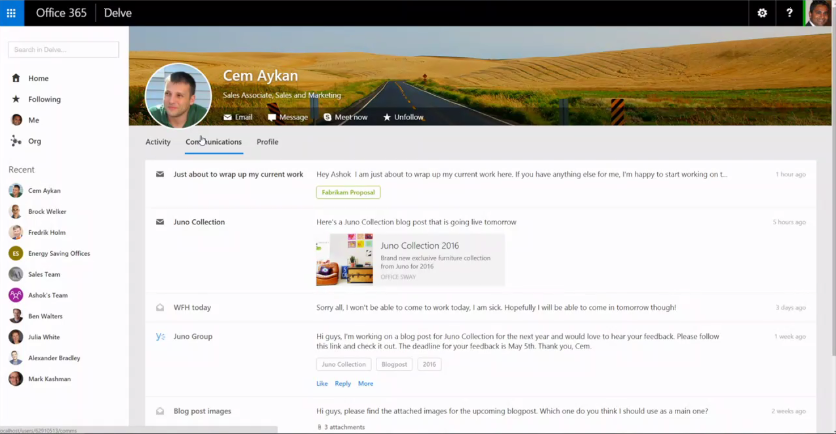

Slide 26
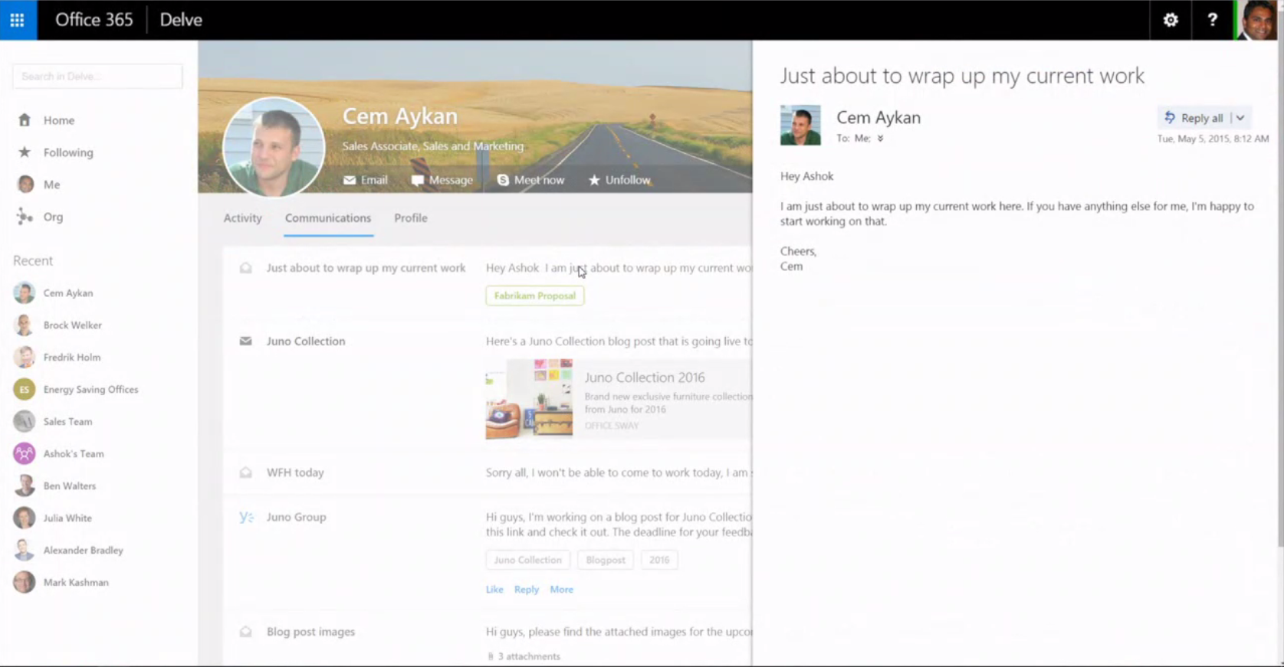

Slide 27
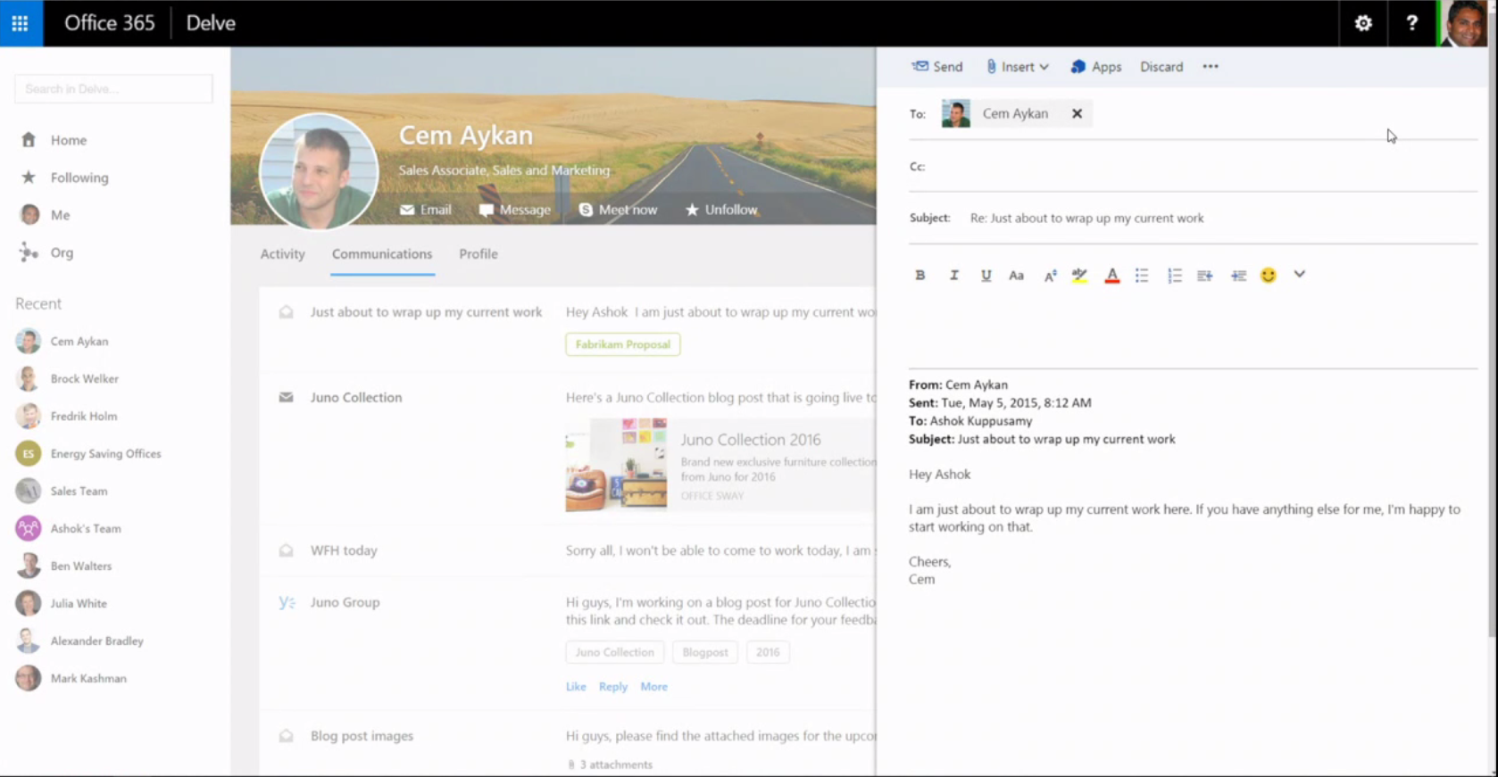

Slide 28
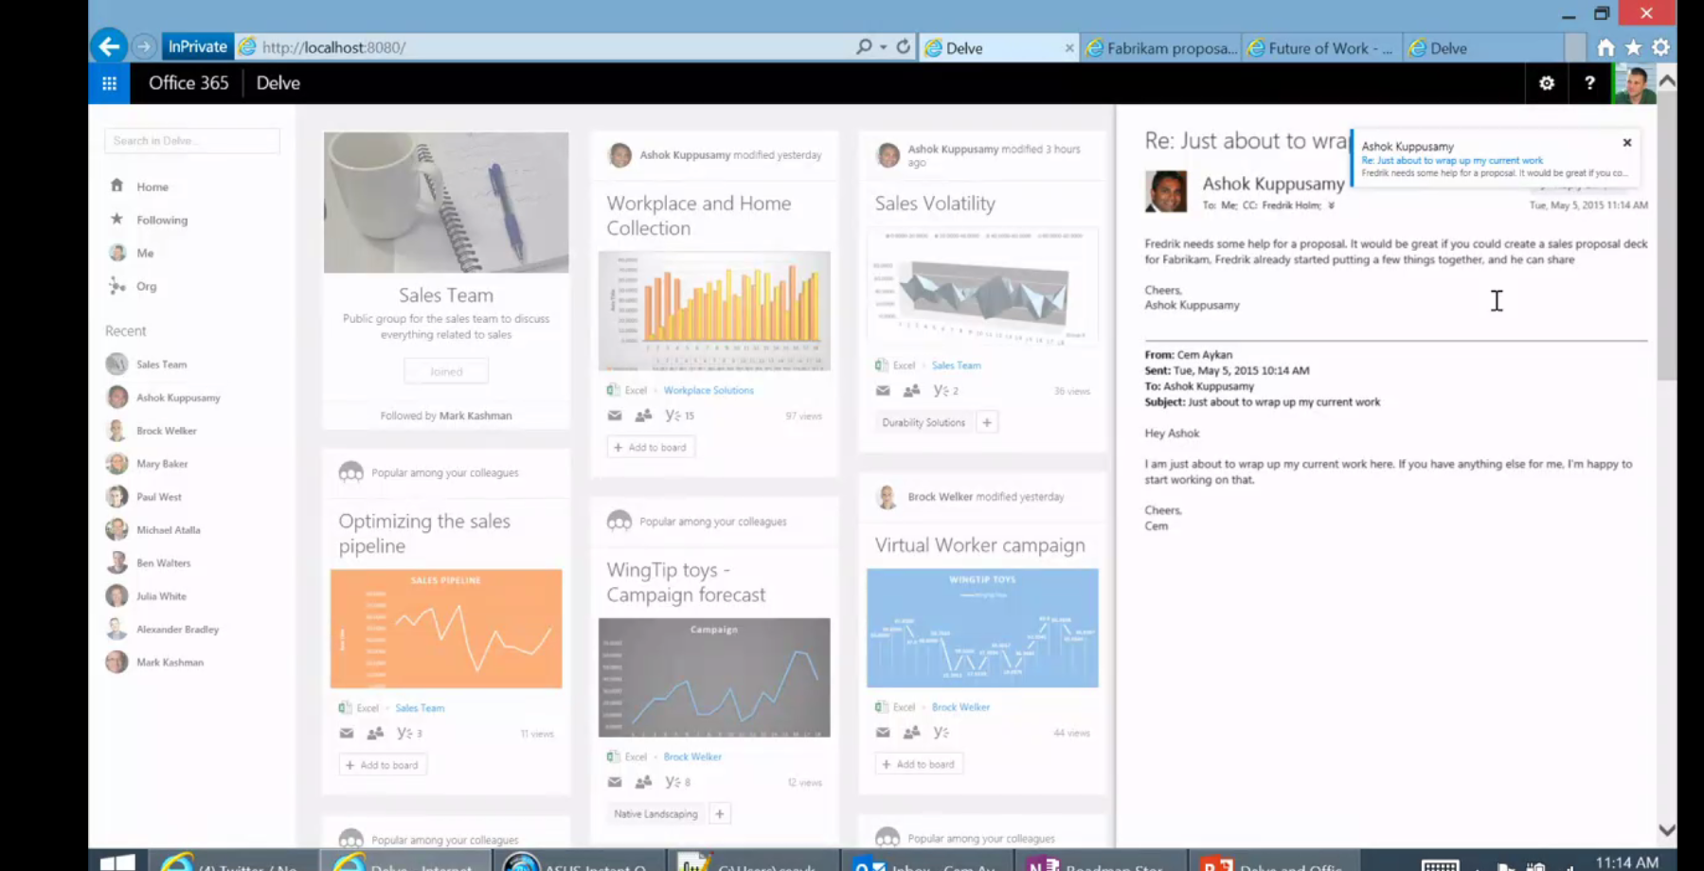

Slide 29
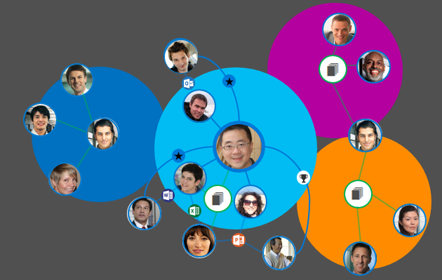
Today, siloed tools and teams…
Hierarchical and siloed teams

Slide 30

Who does what and who knows what?

Slide 31




/users
manager
ME
Workswith
GROUPS
memberOf

Slide 32
/messages
MESSAGES
manager
ME
directReports
GROUPS
memberOf

Slide 33
/events
MESSAGES
MESSAGES
manager
ME
directReports
EVENTS
GROUPS
memberOf

Slide 34




/files
MESSAGES
manager
ME
modifiedBy
directReports
shared
directReports
directReports
EVENTS
EVENTS
FILES
GROUPS
memberOf

Slide 35

/groups
MESSAGES
manager
ME
modifiedBy
shared
modifiedBy
directReports
shared
directReports
EVENTS
FILES
FILES
GROUPS
GROUPS
memberOf
memberOf
modifiedBy
createdBy

Slide 36

/groups
MESSAGES
CONVERSATIONS
manager
ME
modifiedBy
directReports
shared
EVENTS
workingWith
FILES
GROUPS
memberOf
modifiedBy
modifiedBy
createdBy
createdBy
FILES

Slide 37
/workingWith
MESSAGES
CONVERSATIONS
CONVERSATIONS
manager
ME
modifiedBy
directReports
shared
EVENTS
EVENTS
workingWith
FILES
GROUPS
GROUPS
memberOf
memberOf
modifiedBy
workingWith
createdBy
FILES

Slide 38
/trendingAround
MESSAGES
CONVERSATIONS
trendingAround
manager
ME
directReports
shared
modifiedBy
EVENTS
workingWith
workingWith
FILES
GROUPS
memberOf
modifiedBy
workingWith
workingWith
trendingAround
createdBy
FILES

Slide 39

Office Graph
MESSAGES
CONVERSATIONS
trendingAround
manager
ME
directReports
shared
modifiedBy
EVENTS
workingWith
FILES
TASKS
NOTES
GROUPS
memberOf
modifiedBy
workingWith
trendingAround
createdBy
FILES

Slide 40

Signals
Click/Open
Share
Social comments
Presented to
Search
Modify/Save
Follow
Email
Meetings
Lync
Social gestures
Video
Ignore
External API/Partner/etc..

Slide 41
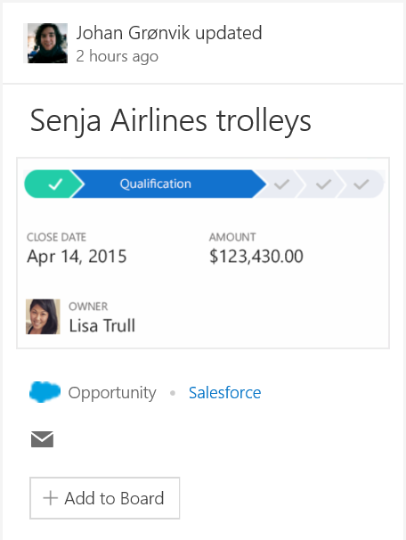
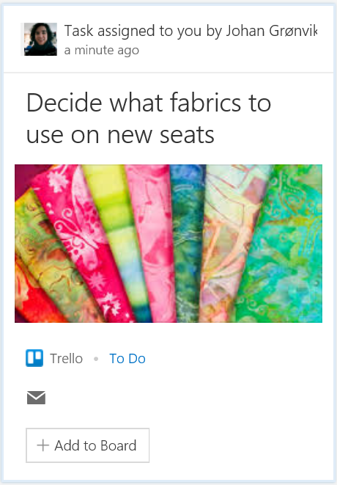

Office Graph Extensibility
GQL
Content & Enrichment API’s
Query API’s
1
2
Ability to connect to LOB and 3rd party services
Expand coverage and value of first party apps
Classification, concept and expertise detection
SharePoint 2016 – Hybrid connectivity
Sneak peak @ Build/Ignite
Graph Query API’s for building rich apps
Sprinkle intelligence to existing apps
Access data from across workloads vs silo
Preview @ Build/Ignite

Slide 42

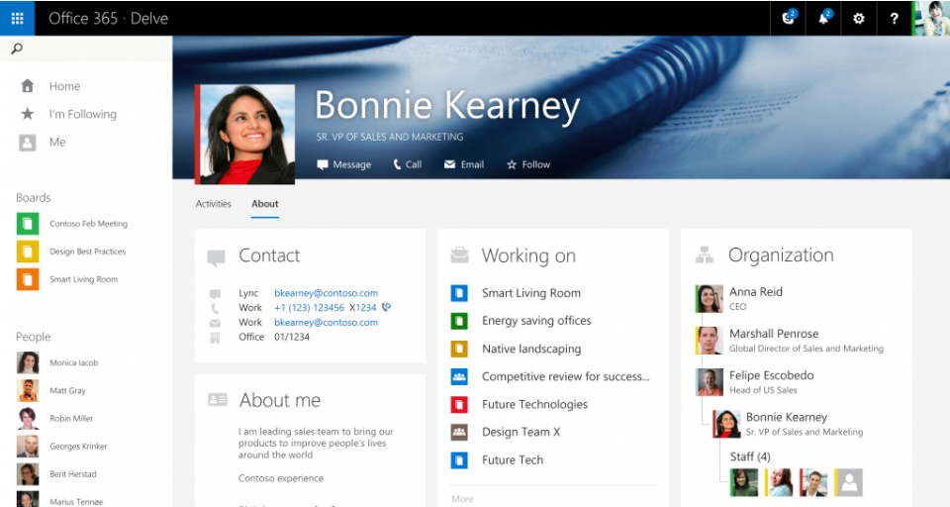
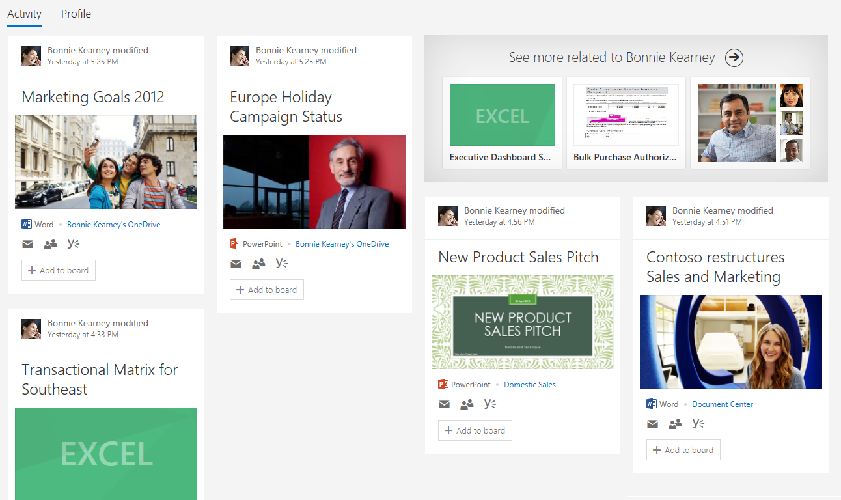
People Experiences in Delve
Coming Soon
Finding Content through People
Finding People through Content
Why people?
Evolution of Delve
A few slides
Wrap-up

Slide 43
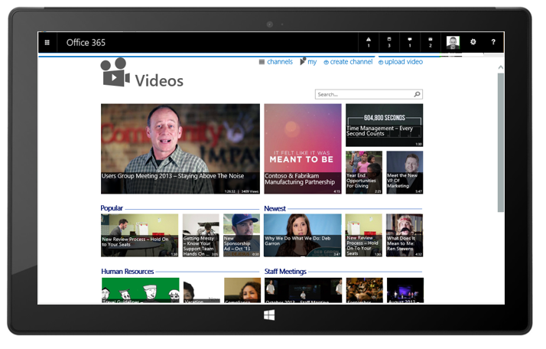
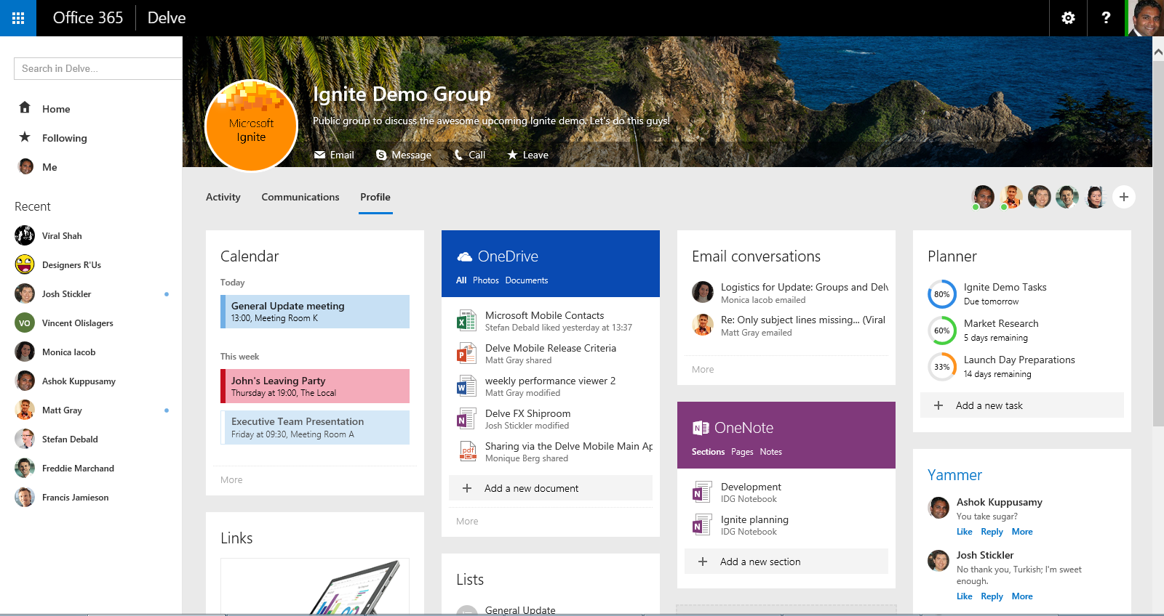
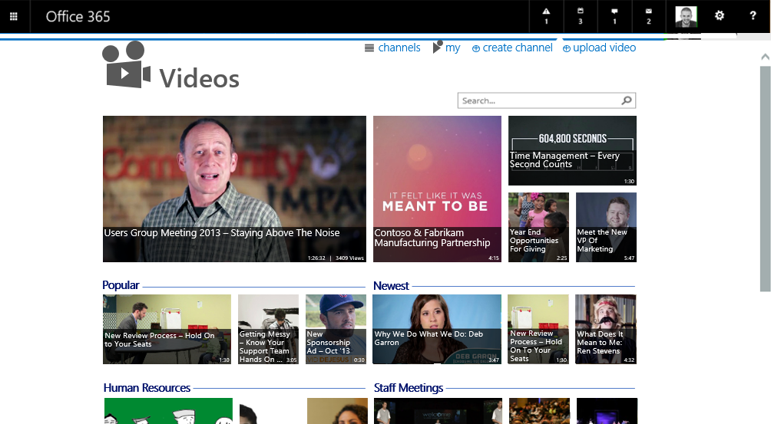
Group Insights in Delve
Near Future
Discover and connect through Groups
Delve stitches together all recent activity around a group for quick insights and access
Easily get back to the people and groups that matter most

Slide 44
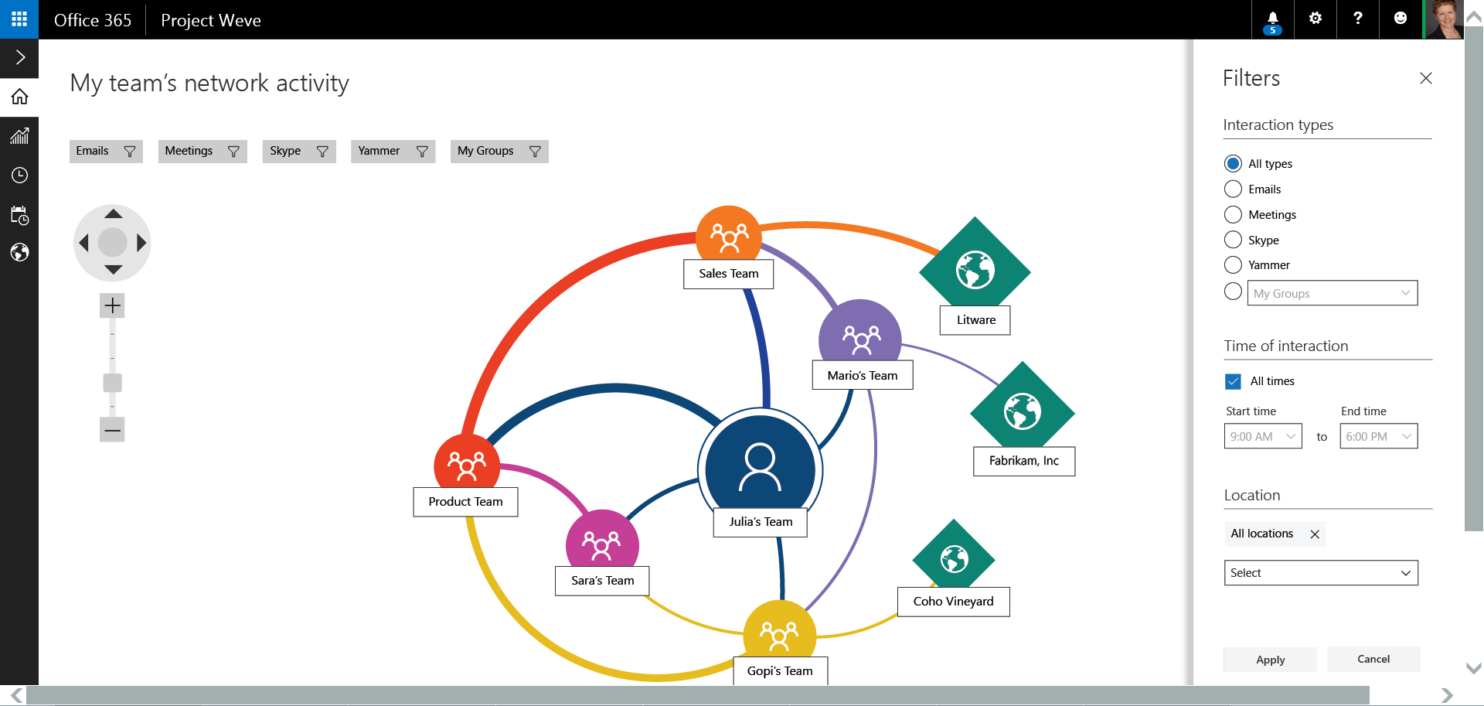
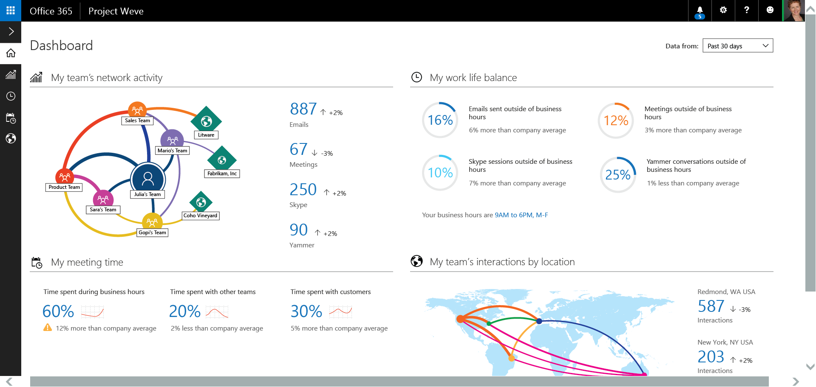
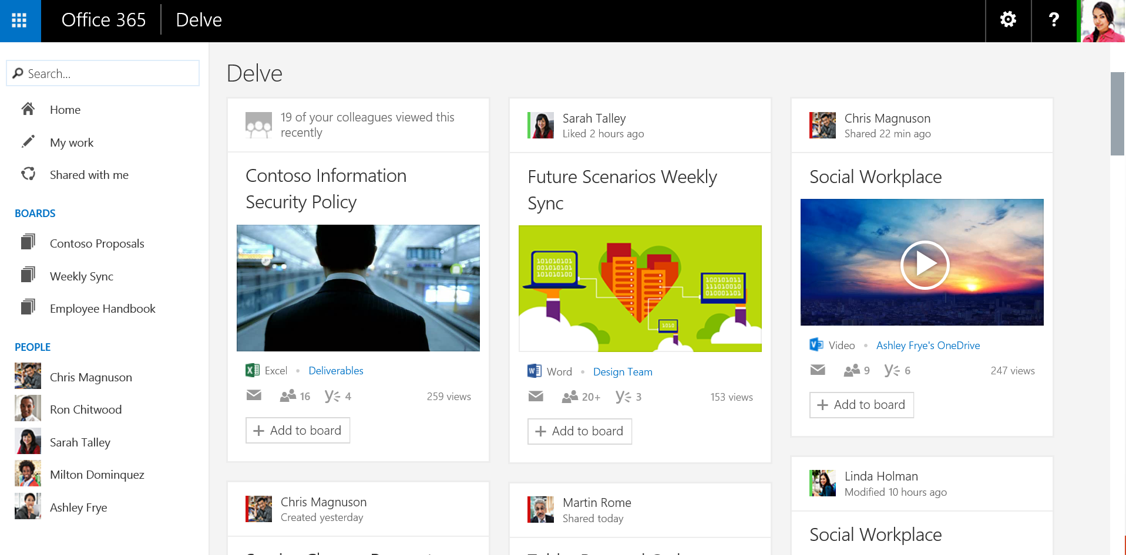
Organizational Insights
Future
Drill down on time spent on various activities and identify patterns
Rich Interactive dashboards, promoting visual discovery and insights for people and teams
Identify opportunities to improve cross team collaboration.

Slide 45






Public and Private Signals Always Respect Permissions
Email
Presented to me
Manager
Direct report
Shared with me
Public Groups
Viewed by me

Slide 46

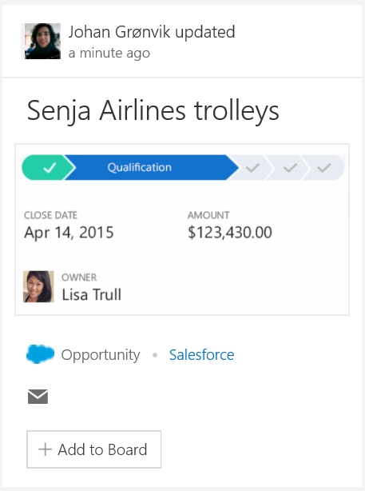
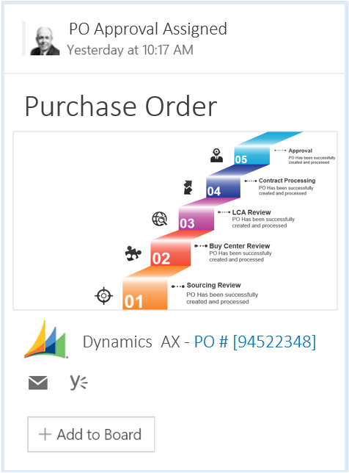
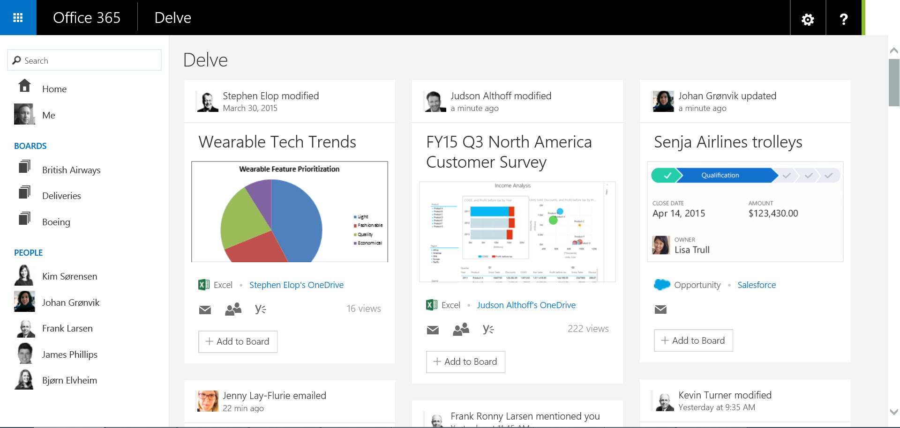
Extensibility

Slide 47
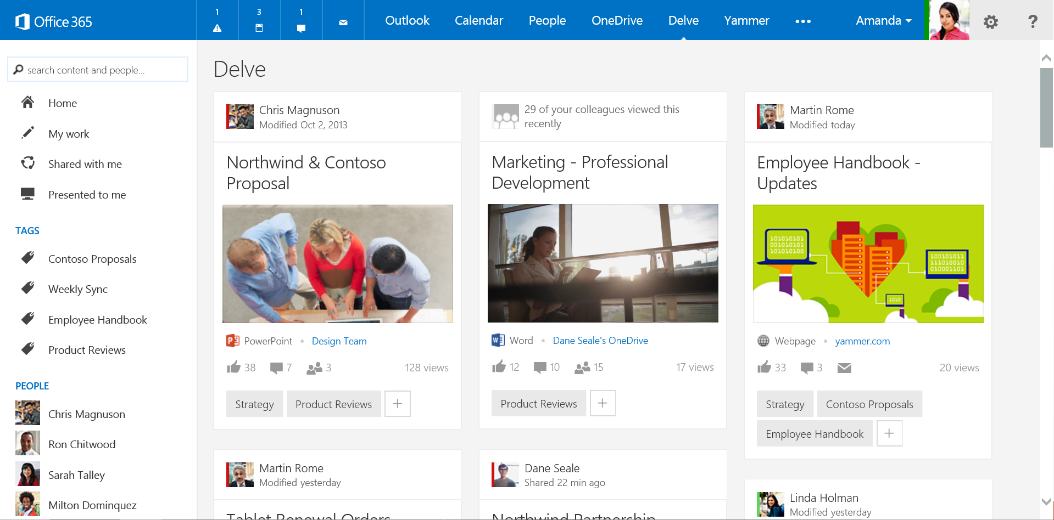
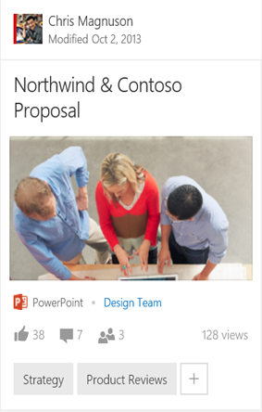
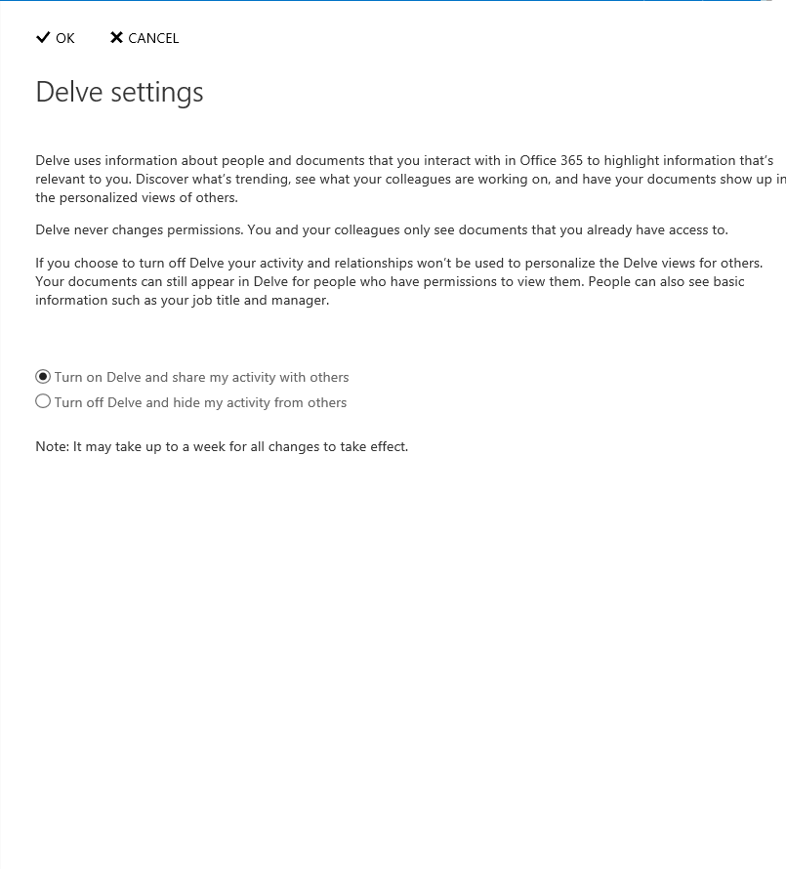
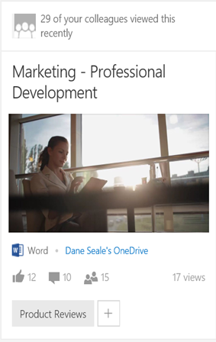
Transparency and Control
Insights on how this relates to you
Both tenant and user level opt-in/opt-out settings
Discovery that respects permissions
Control access to your content and share with others

Slide 48
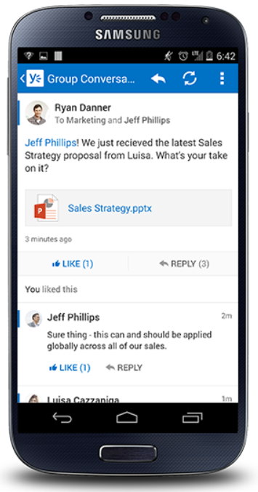
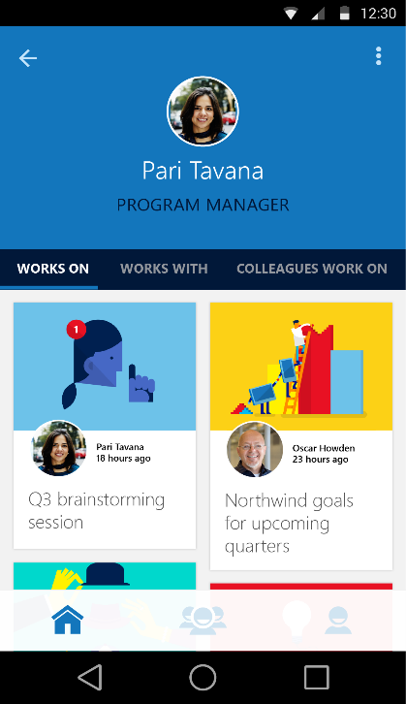
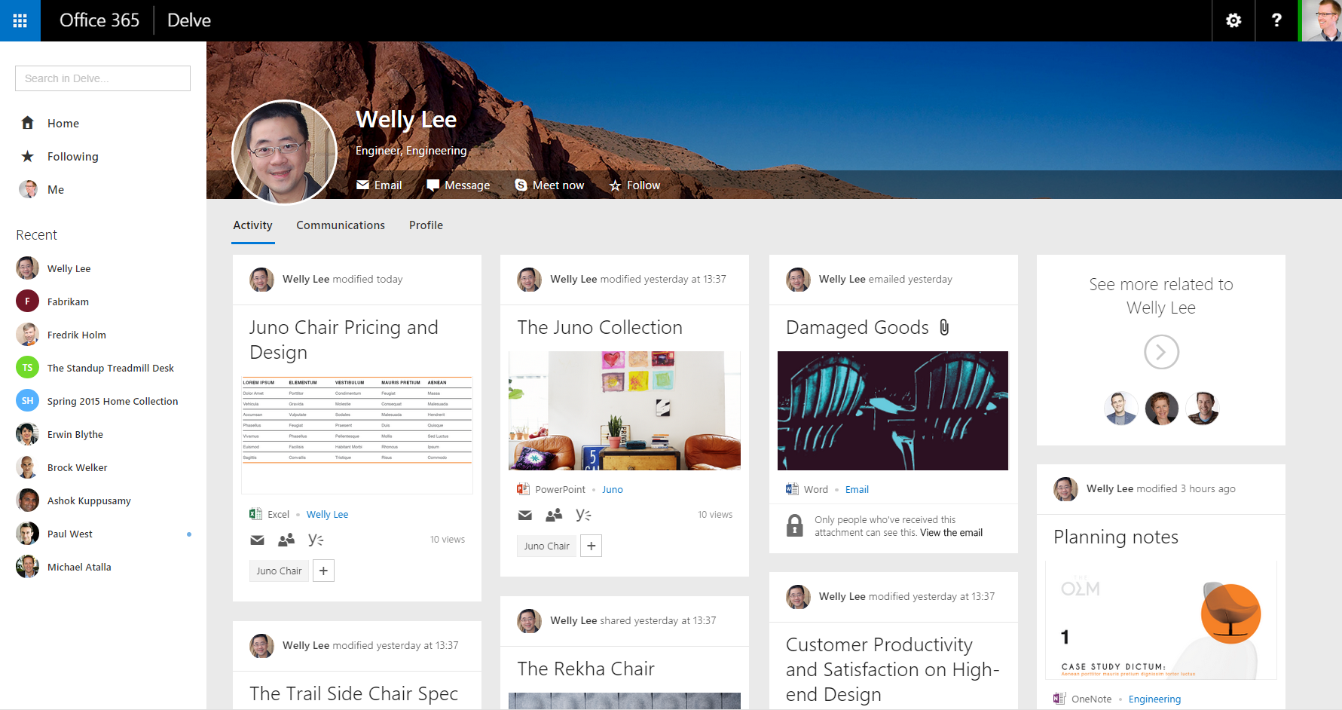
Finding Content through People
http://aka.ms/DelveAndroid
http://aka.ms/DelveIphone
Stay informed and productive even on the go
People as proxy to information.

Slide 49
Delve App Demo

Slide 50
What if I want more control over content curation?
…manage exactly who can add content
…order the content
…annotate, explain or provide context
...highlight or crack open certain content
…show related content
Microsites
Notes:
Eg. Contributing to a company-wide topic Eg. The must-see documents in my group folder
Eg. All powerpoints for an offsite sitting on different Onedrives
When you want to pull together fresh information from different places and different people
When you want to focus attention on a subset of documents
When you want to re-use and build upon existing knowledge

Slide 51
KM Strategy
Boards
Microsite
Codename
Infopedia
Delve
Microsites provide more control and context around a collection
Delve
“InfoPedia”
Bottom-up
(Usage)
Top-down
(Value)
Enhanced by key Office 365 Capabilities
Office Graph
Office Add-Ins
OneDrive
Skype
Outlook
Compliance Center
Yammer
SharePoint Content Management
Azure Media & other Azure PaaS Services

Slide 52

Microsites

Slide 53
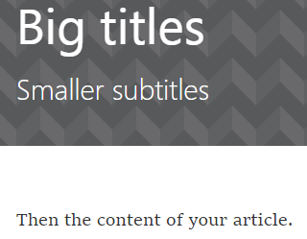





Microsites and Articles at a Glance
Content-first you focus on content; we format on any device
Rich documents show off the most important content in your Office docs
Rich text as easy as Word or email with toolbox and hinting system
Social have conversations about them; like them; see view counts
Dynamic & Beautiful anything you write just looks great
Integrated with email mail out rich articles and attract readers to your microsite
Notes:
Articles let you organize information on a page
Explain and showcase O365 assets
Connect and relate your information through graph insights and curation
Communicate to your audience and understand your impact

Slide 54

Graph-driven Insights
Your articles can rapidly become obsolete It can be expensive to keep them fresh Graph insights can help you out By mining documents around you and your users, we can keep them relevant

Slide 55

Predicted Documents
We encourage users to add document references with an inline-file picker
It predicts what you most want to add from your recent activity

Slide 56

From Boards to Articles
Ideas in the pipeline

Slide 57

Code-name Infopedia Mock-up
An online knowledge shop:
…with personalized recommendations
…organized around your company
…with great search
A Vision

Slide 58


Slide 59


Slide 60


Slide 61


Slide 62


Slide 63


Slide 64


Slide 65
KM Strategy
Boards
Microsite
Codename
Infopedia
Delve
Microsites provide more control and context around a collection
Delve
“InfoPedia”
Bottom-up
(Usage)
Top-down
(Value)

Slide 66
Q&A
@pabloperis
pablop@microsoft.com

Slide 67



¡Completa tu pasaporte!
Debes recorrer todos los stand de la conferencia
Solicita en cada stand su pegatina
Pégalas todas en el pasaporte
Una vez relleno, solicita a la azafata del mostrador interno (al lado del auditorio) tu número de participación
¡El pasaporte completo te permitirá participar en el sorteo de los regalos de la conferencia!

Slide 68

¡Rellena tu encuesta!
No olvides rellenar las dos hojas de encuesta.
Una vez relleno, entrégala a la azafata del mostrador interno (al lado del auditorio).
La azafata te entregará la bolsa con el regalo de la conferencia.

